Slide 1
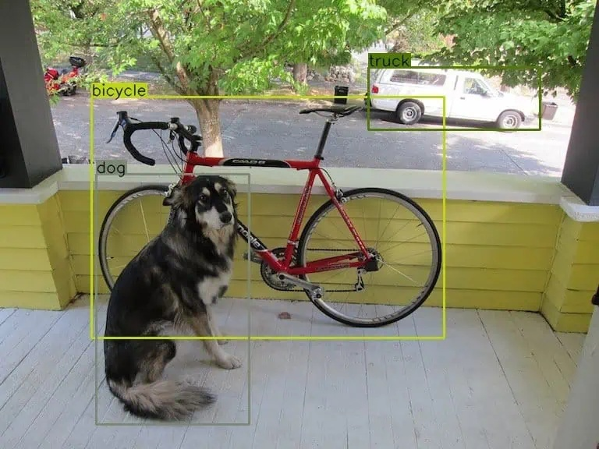
SESSION 10
Object Detection
& YOLO
From R-CNN Foundations to Real-Time YOLOv8
TYPE
Phase 3 — Core CV Tasks | Week 7
Theory + Hands-On

Slide 2

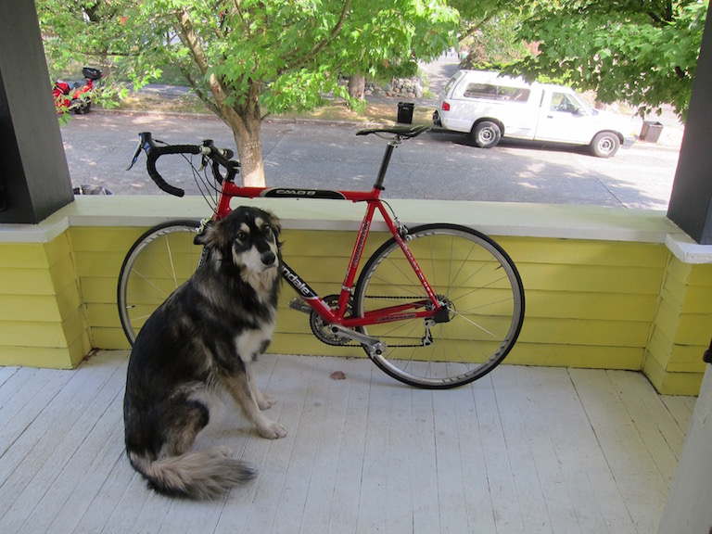





Today's Agenda
1
What is Object Detection?
Classification vs detection vs segmentation
2
Two-Stage Detectors
R-CNN → Fast R-CNN → Faster R-CNN evolution
3
Core Concepts
Anchor boxes, IoU, NMS, and mAP
4
Enter YOLO
One-stage detection philosophy
Can a machine detect every
object in this image?
5
YOLOv8 Architecture
Backbone, neck, and head deep-dive
6
Ultralytics Quickstart
Hands-on: inference, training, and evaluation

Slide 3
What is Object Detection?
Classification
Detection
Segmentation
"What is in the image?"
"What & where?"
"Exact pixel boundaries"
Single label for the
entire image
Output: class + confidence
Locate every object
with a bounding box
Output: boxes + classes
Classify each pixel
belonging to objects
Output: pixel-level masks
→ "dog" (97%)
→ dog, bicycle, truck
→ precise outlines
Object Detection = Classification + Localisation (for every object in the image)

Slide 4
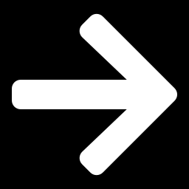



The Detection Problem
Input
Output
Bounding Box
Class Label
Confidence
(x, y, w, h)
dog, bicycle, truck
0.0 → 1.0 score

Slide 5

Two-Stage Detectors: The R-CNN Family
R-CNN
~50s
Fast R-CNN
~2s
Faster R-CNN
~0.2s
Selective Search → 2000 regions → CNN each → SVM classify
CNN on full image once → RoI pooling → classify + regress
Region Proposal Network (RPN) replaces Selective Search
2014
2015
2015
First deep-learning detector
Shared CNN computation
End-to-end trainable, much faster
Extremely slow
Still uses Selective Search
Still two stages
Key Idea: Two-stage = (1) propose regions → (2) classify each region

Slide 6
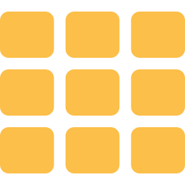
Anchor Boxes & IoU
Anchor Boxes
IoU — Intersection over Union
Pre-defined boxes of various shapes and sizes placed at every position in the feature map
IoU = Area of Overlap / Area of Union
Predicted
Ground
Truth
Tall & Narrow
Square
Wide & Short
People, poles
Faces, signs
Cars, buses
The network predicts offsets to refine
these anchors into tight bounding boxes
IoU < 0.5
Poor match
IoU ≥ 0.5
Acceptable (standard threshold)
IoU ≥ 0.75
Good match

Slide 7

Non-Maximum Suppression (NMS)
Problem: Detectors produce many overlapping boxes for the same object. NMS keeps only the best one.
1
2
3
4
5
Sort by
Confidence
Pick Top
Box
Compute
IoU
Suppress
Overlap
Repeat
Rank all boxes by their confidence scores (highest first)
Select the box with the highest confidence as a detection
Calculate IoU of remaining boxes with the selected box
Remove boxes with IoU > threshold (e.g., 0.5) — they detect the same object
Go to step 2 with remaining boxes until none are left

Slide 8
Evaluation: mAP (mean Average Precision)
Building Blocks
Common Variants
Precision = TP / (TP + FP)
mAP@0.5
"Of all detections, how many are correct?"
IoU threshold = 0.5
(PASCAL VOC standard)
Recall = TP / (TP + FN)
"Of all real objects, how many did we find?"
mAP@0.75
AP (Average Precision)
IoU threshold = 0.75
(stricter matching)
Area under the Precision-Recall curve for a single class
mAP (mean AP)
mAP@[.5:.95]
Average of AP across all classes — the standard detection metric
Average over IoU from 0.5 to 0.95
in steps of 0.05 (COCO standard)
mAP = (1/N) × Σ AP_i for all N classes

Slide 9

PART 2
You Only
Look Once
Speed Comparison
R-CNN
0.02 FPS
Fast R-CNN
0.5 FPS
The One-Stage Detection Revolution
Faster R-CNN
5 FPS
YOLOv1
45 FPS
Instead of proposing regions then classifying,
YOLO frames detection as a single regression problem.
YOLOv8n
600+ FPS

Slide 10

YOLO Evolution
YOLOv1
YOLOv3
YOLOv8
Single-pass detection
45 FPS on GPU
Darknet-53 backbone
FPN neck, 3 scales
Anchor-free, C2f
Ultralytics unified CLI
2016
2017
2018
2020
2023
YOLOv2
YOLOv5
Batch norm, anchor
boxes, multi-scale
PyTorch-native
Ultralytics ecosystem
We focus on YOLOv8 — the current standard with the best speed-accuracy trade-off and the Ultralytics ecosystem

Slide 11

YOLOv8 Architecture
Backbone
Neck
Head
Feature Extraction
Feature Fusion
Prediction
CSPDarknet architecture
FPN (Feature Pyramid Network)
Decoupled head design
C2f modules (Cross Stage Partial)
PAN (Path Aggregation Network)
Separate branches for:
Extracts multi-scale features
Combines low-level + high-level features
• Classification (what?)
Progressively reduces spatial size
Enables detection at 3 scales:
• Bounding box regression (where?)
Increases channel depth
small, medium, and large objects
Anchor-free predictions

Slide 12
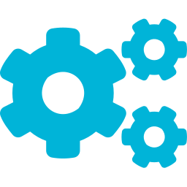

YOLOv8 Key Innovations
Anchor-Free Detection
C2f Module
No predefined anchor boxes — the model directly predicts the center and size of objects. Reduces hyperparameters and speeds up post-processing.
Cross Stage Partial with flow — splits features, processes through bottleneck blocks, then concatenates. Better gradient flow than CSP.
Decoupled Head
Task-Agnostic Design
Separate branches for classification and regression. Each task gets its own convolutional layers — improves both accuracy and convergence.
Same architecture supports detection, segmentation, classification, pose estimation, and OBB — just swap the head module.

Slide 13
YOLOv8 Model Variants
Model | Params | mAP@50-95 | Speed (ms) | Best For
YOLOv8n | 3.2M | 37.3 | 1.21 | Edge / mobile / real-time
YOLOv8s | 11.2M | 44.9 | 1.40 | Balanced speed & accuracy
YOLOv8m | 25.9M | 50.2 | 2.65 | General purpose
YOLOv8l | 43.7M | 52.9 | 4.02 | High accuracy needs
YOLOv8x | 68.2M | 53.9 | 6.16 | Maximum accuracy
Naming Convention: n = nano, s = small, m = medium, l = large, x = extra-large
Task suffixes: -seg (segmentation), -pose (keypoints), -cls (classification), -obb (oriented bbox)

Slide 14
Ultralytics Quickstart
Installation
CLI Commands
pip install ultralytics
# Predict
yolo predict model=yolov8n.pt \
source='image.jpg'
Run Inference (Python)
from ultralytics import YOLO
# Load a pretrained model
model = YOLO('yolov8n.pt')
# Run inference
results = model('image.jpg')
# Show results
results[0].show()
Train on Custom Data
# Train
model = YOLO('yolov8n.pt')
model.train(
data='dataset.yaml',
epochs=100, imgsz=640
)
Ultralytics provides a unified Python API and CLI for train, val, predict, and export across all YOLO tasks

Slide 15

YOLO in Action
DETECTION RESULTS
dog
98%
[102, 208, 325, 542]
bicycle
95%
[82, 98, 580, 440]
truck
91%
[468, 72, 680, 170]
3 objects detected
Inference: ~5ms on GPU

Slide 16
Summary & Next Steps
WHAT WE COVERED
COMING UP NEXT
Object detection vs classification vs segmentation
YOLO Training Lab
R-CNN → Fast R-CNN → Faster R-CNN evolution
Custom dataset with Roboflow, train & evaluate
Anchor boxes, IoU, NMS, and mAP metrics
Semantic Segmentation
FCN, U-Net architecture & use-cases
YOLO philosophy: one-stage detection
YOLOv8 architecture (backbone, neck, head)
Instance Segmentation
Mask R-CNN / YOLOv8-seg hands-on
Ultralytics Python API and CLI quickstart
Session 10 | Object Detection & YOLO | Phase 3 — Core CV Tasks

